Slide 1
Chapter 4
Scatterplots and Correlation
*
Chapter 4
‹#›
Notes:
HS 67
*
Chapter 4 (Correlation)
‹#›

Slide 2
Explanatory Variable and Response Variable
Correlation describes linear relationships between quantitative variables
X is the quantitative explanatory variable
Y is the quantitative response variable
Example: The correlation between per capita gross domestic product (X) and life expectancy (Y) will be explored
*
Chapter 4
‹#›

Slide 3
Data (data file = gdp_life.sav)
Country | Per Capita GDP (X) | Life Expectancy (Y)
Austria | 21.4 | 77.48
Belgium | 23.2 | 77.53
Finland | 20.0 | 77.32
France | 22.7 | 78.63
Germany | 20.8 | 77.17
Ireland | 18.6 | 76.39
Italy | 21.5 | 78.51
Netherlands | 22.0 | 78.15
Switzerland | 23.8 | 78.99
United Kingdom | 21.2 | 77.37
*
Chapter 4
‹#›

Slide 4
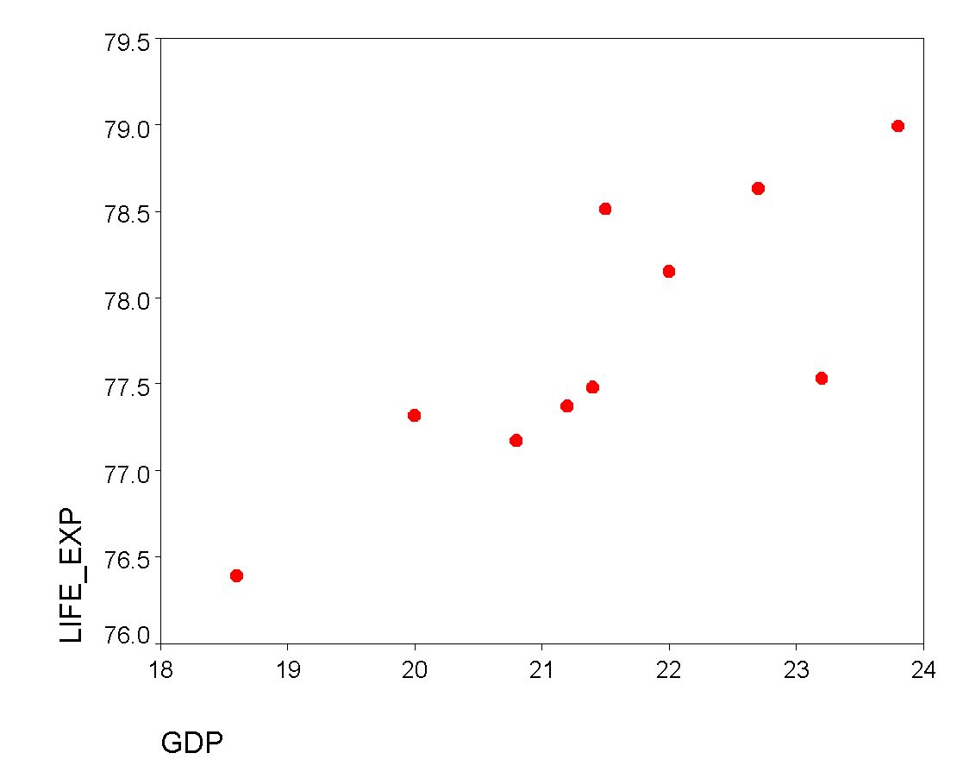
Scatterplot: Bivariate points (x_{i}, y_{i})
This is the data point for Switzerland (23.8, 78.99)
*
Chapter 4
‹#›

Slide 5
Interpreting Scatterplots
Form: Can relationship be described by straight line (linear)? ..by a curved line? etc.
Outliers?: Any deviations from overall pattern?
Direction of the relationship either:
Positive association (upward slope)
Negative association (downward slope)
No association (flat)
Strength: Extent to which points adhere to imaginary trend line
*
Chapter 4
‹#›

Slide 6
Example: Interpretation
Here is the scatterplot we saw earlier:
This is the data point for Switzerland (23.8, 78.99)
Interpretation:
Form: linear (straight)
Outliers: none
Direction: positive
Strength: difficult to judge by eye
*
Chapter 4
‹#›

Slide 7
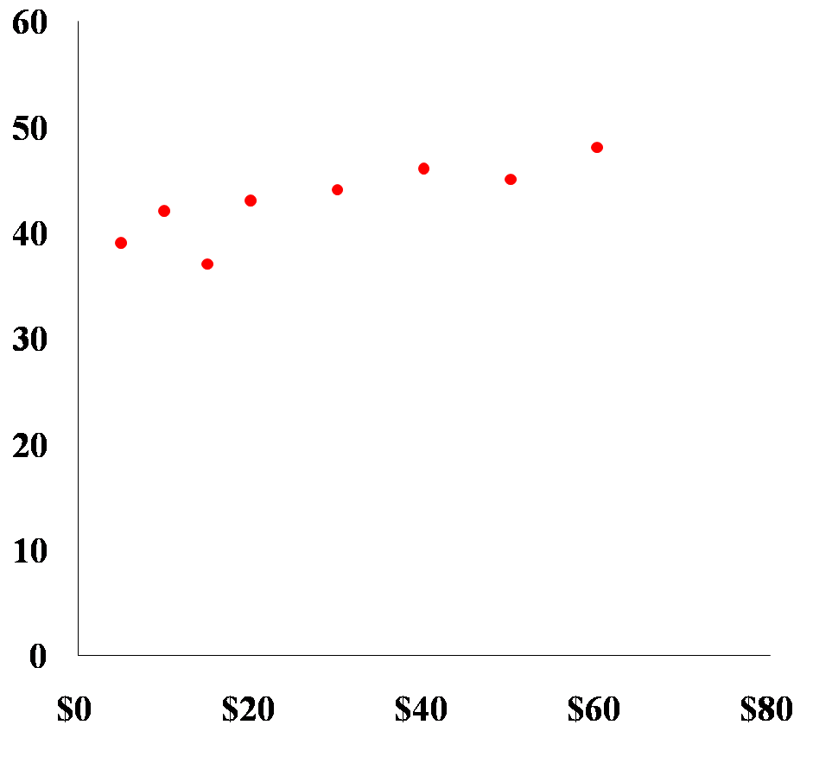
Example 2
Interpretation
Form: linear
Outliers: none
Direction: positive
Strength: difficult to judge by eye (looks strong)
*
Chapter 4
‹#›
Notes:
HS 67
*
Chapter 4 (Correlation)
‹#›

Slide 8
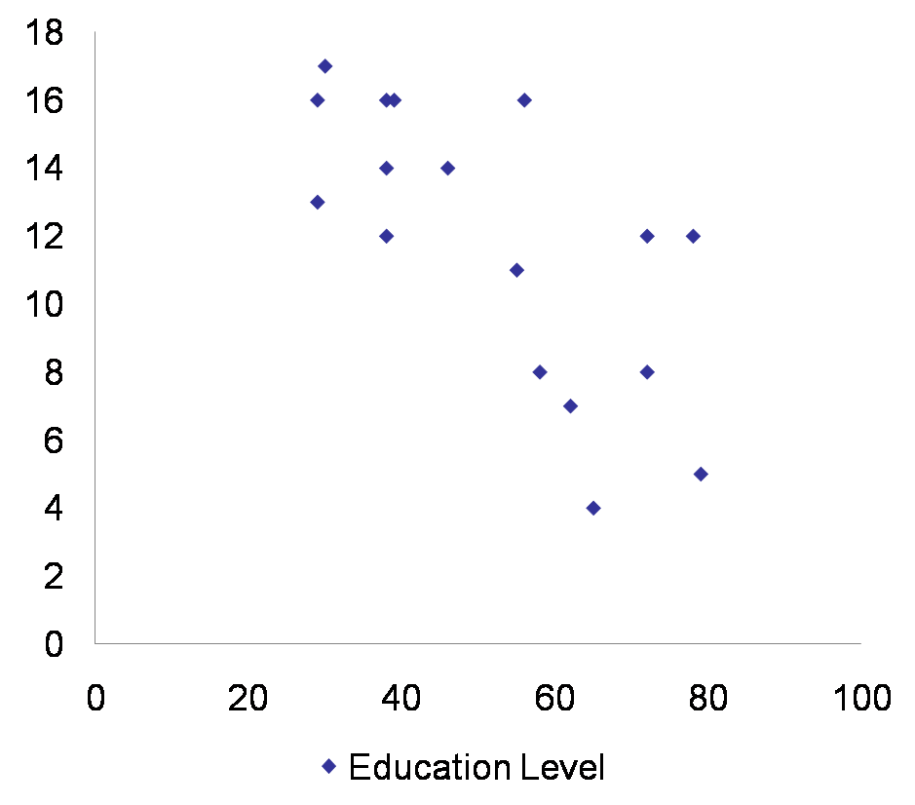
Example 3
Form: linear
Outliers: none
Direction: negative
Strength: difficult to judge by eye (looks moderate)
*
Chapter 4
‹#›
Notes:
HS 67
*
Chapter 4 (Correlation)
‹#›

Slide 9
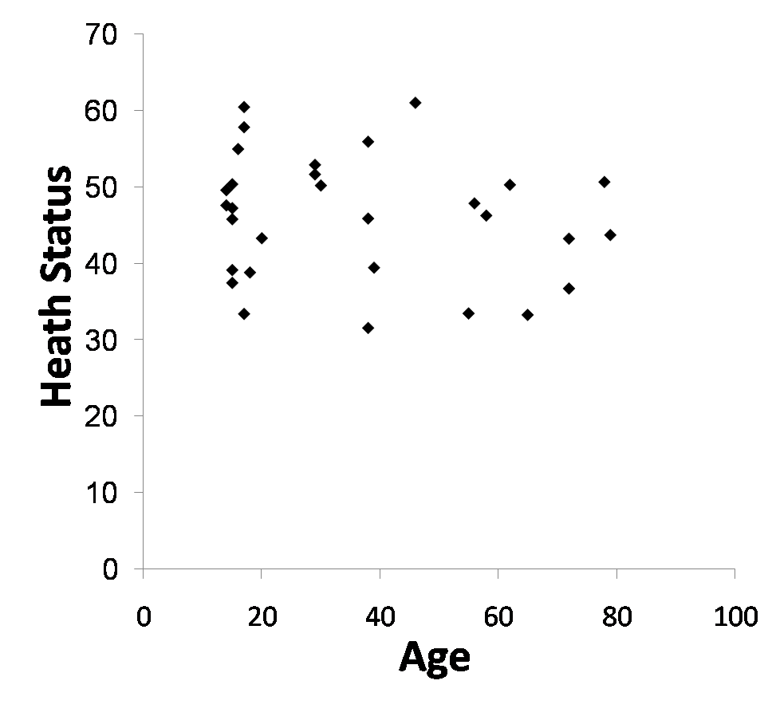
Example 4
Form: linear(?)
Outliers: none
Direction: negative
Strength: difficult to judge by eye (looks weak)
*
Chapter 4
‹#›
Notes:
HS 67
*
Chapter 4 (Correlation)
‹#›

Slide 10
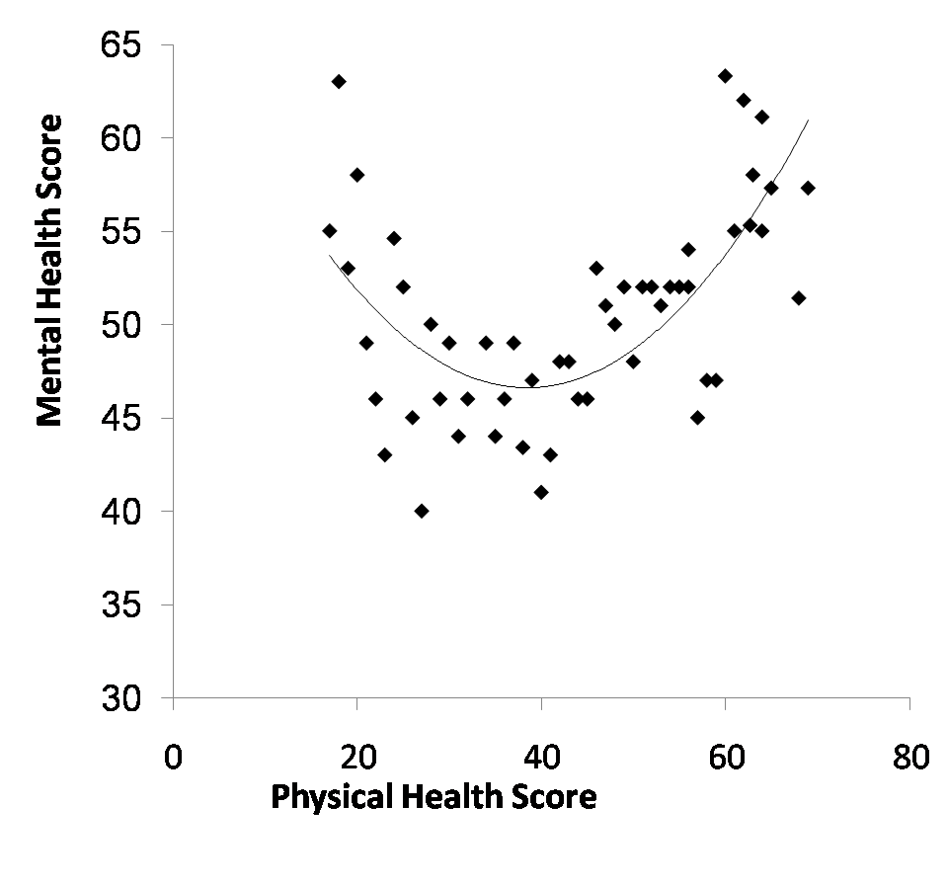
Interpreting Scatterplots
Form: curved
Outliers: none
Direction: U-shaped
Strength: difficult to judge by eye (looks moderate)
*
Chapter 4
‹#›
Notes:
HS 67
*
Chapter 4 (Correlation)
‹#›

Slide 11
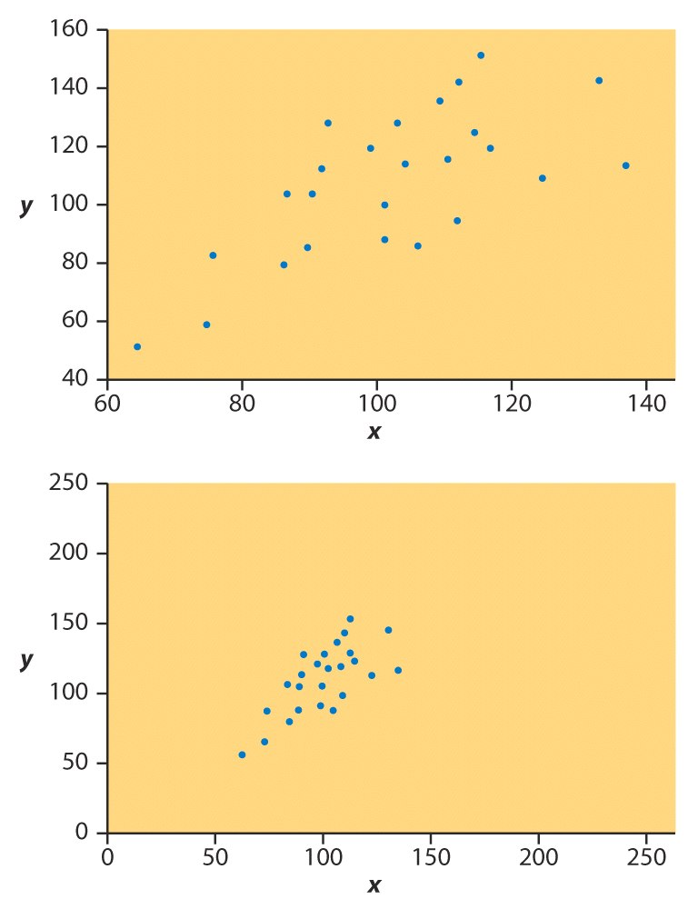
Correlational Strength
It is difficult to judge correlational strength by eye alone
Here are identical data plotted on differently axes
First relationship seems weaker than second
This is an artifact of the axis scaling
We use a statistical called the correlation coefficient to judge strength objectively
*
Chapter 4
‹#›

Slide 12
Correlation coefficient (r)
r ≡ Pearson’s correlation coefficient
Always between −1 and +1 (inclusive)
r = +1 ⇒ all points on upward sloping line
r = -1 ⇒ all points on downward line
r = 0 ⇒ no line or horizontal line
The closer r is to +1 or –1, the stronger the correlation
*
Chapter 4
‹#›

Slide 13
Interpretation of r
Direction: positive, negative, ≈0
Strength: the closer |r| is to 1, the stronger the correlation
0.0 ≤ |r| < 0.3 ⇒ weak correlation
0.3 ≤ |r| < 0.7 ⇒ moderate correlation
0.7 ≤ |r| < 1.0 ⇒ strong correlation
|r| = 1.0 ⇒ perfect correlation
*
Chapter 4
‹#›

Slide 14
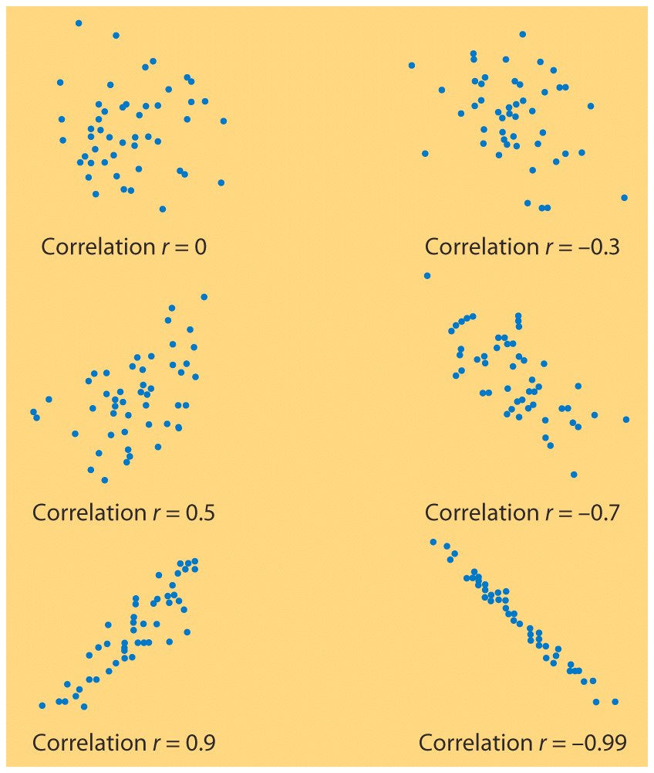
*
Chapter 4
‹#›

Slide 15
More Examples of Correlation Coefficients
Husband’s age / Wife’s age
r = .94 (strong positive correlation)
Husband’s height / Wife’s height
r = .36 (weak positive correlation)
Distance of golf putt / percent success
r = -.94 (strong negative correlation)
*
Chapter 4
‹#›

Slide 16
Calculating r by hand
Calculate mean and standard deviation of X
Turn all X values into z scores
Calculate mean and standard deviation of Y
Turn all Y values into z scores
Use formula on next page
*
Chapter 4
‹#›

Slide 17
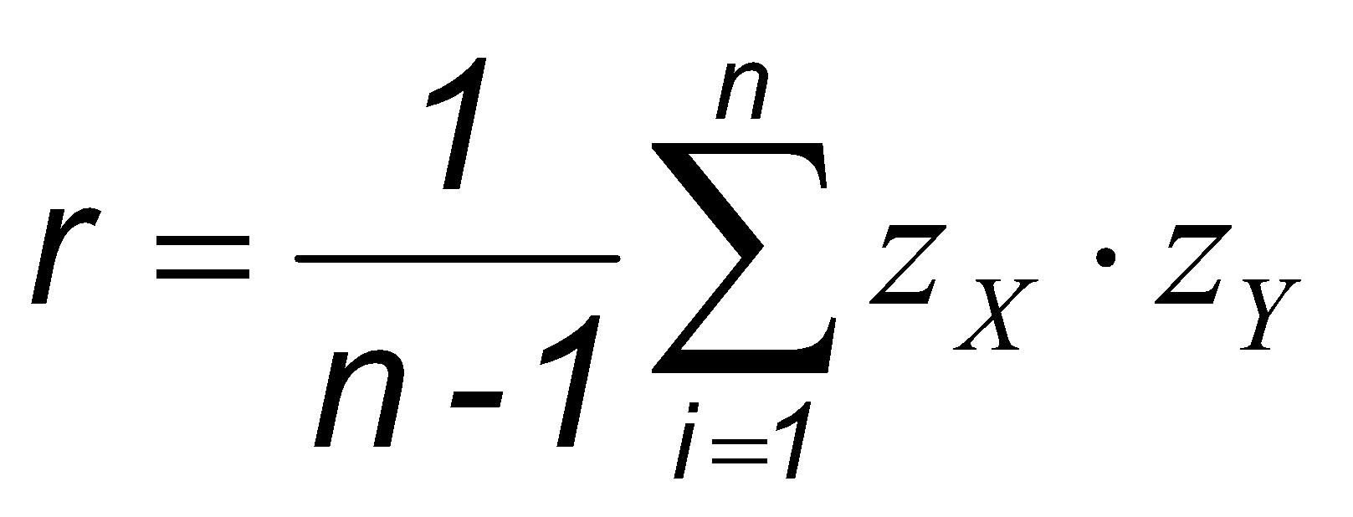
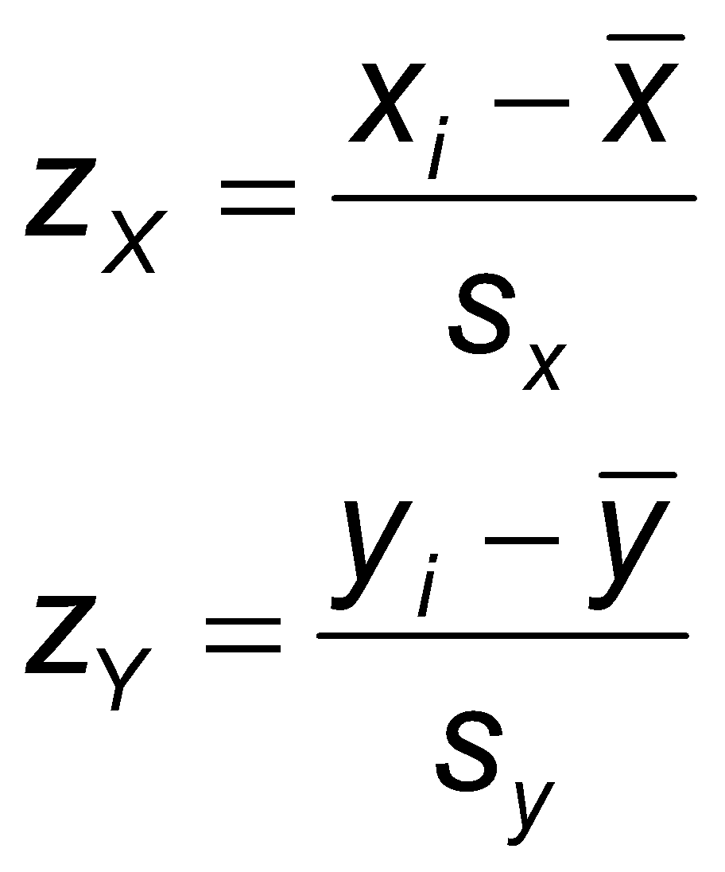
Correlation coefficient r
where
*
Chapter 4
‹#›

Slide 18
Example: Calculating r
X
Y
Z_{X}
Z_{Y}
Z_{X} ∙ Z_{X}
21.4
77.48
-0.078
-0.345
0.027
23.2
77.53
1.097
-0.282
-0.309
20.0
77.32
-0.992
-0.546
0.542
22.7
78.63
0.770
1.102
0.849
20.8
77.17
-0.470
-0.735
0.345
18.6
76.39
-1.906
-1.716
3.271
21.5
78.51
-0.013
0.951
-0.012
22.0
78.15
0.313
0.498
0.156
23.8
78.99
1.489
1.555
2.315
21.2
77.37
-0.209
-0.483
0.101
7.285
Notes: x-bar= 21.52 s_{x} =1.532;
y-bar= 77.754; s_{y} =0.795
*
Chapter 4
‹#›

Slide 19
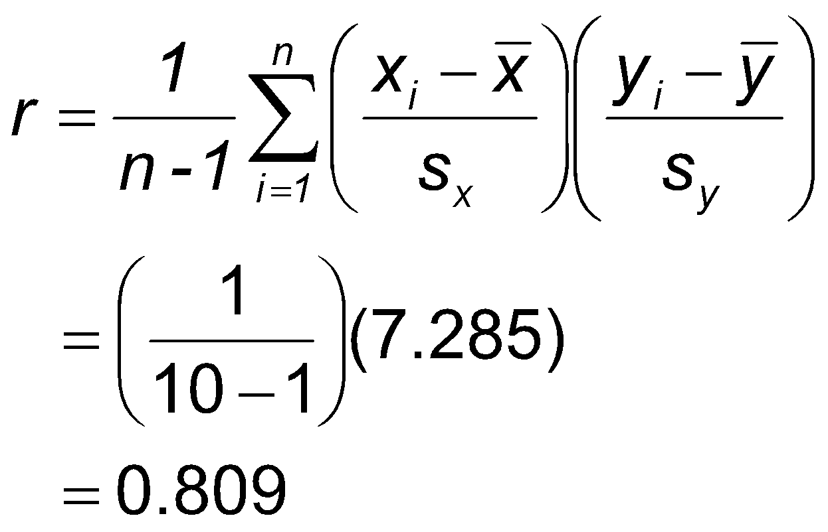
Example: Calculating r
r = .81 ⇒ strong positive correlation
*
Chapter 4
‹#›

Slide 20
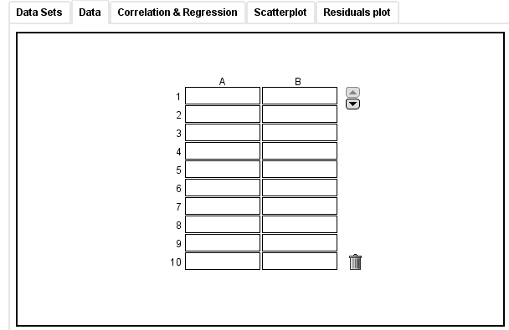
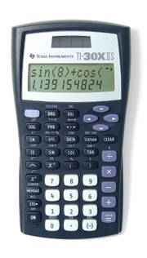
Calculating r
Check calculations with calculator or applet.
Data entry screen of the two variable Applet
that comes with the text
TI two-variable
calculator
*
Chapter 4
‹#›

Slide 21
Beware!
r applies to linear relations only
Outliers have large influences on r
Association does not imply causation
*
Chapter 4
‹#›
Notes:
HS 67
*
Chapter 4 (Correlation)
‹#›

Slide 22
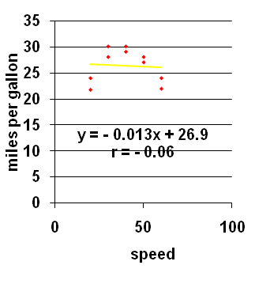
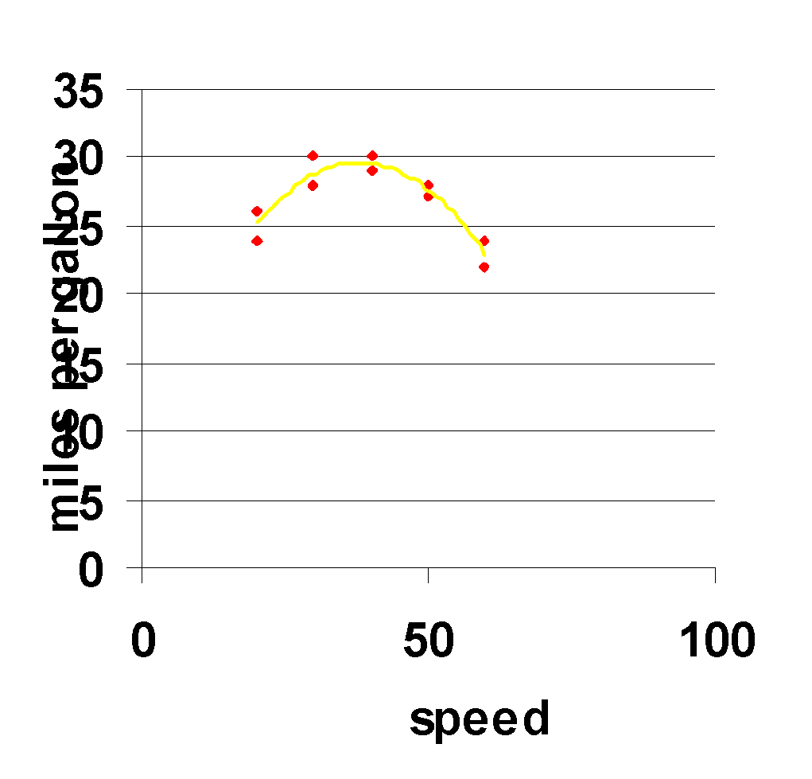
Nonlinear relationships
Figure shows :miles per gallon” versus “speed” (“car data” n = 10)
r ≈ 0; but this is misleading because there is a strong non-linear upside down U-shape relationship
*
Chapter 4
‹#›

Slide 23
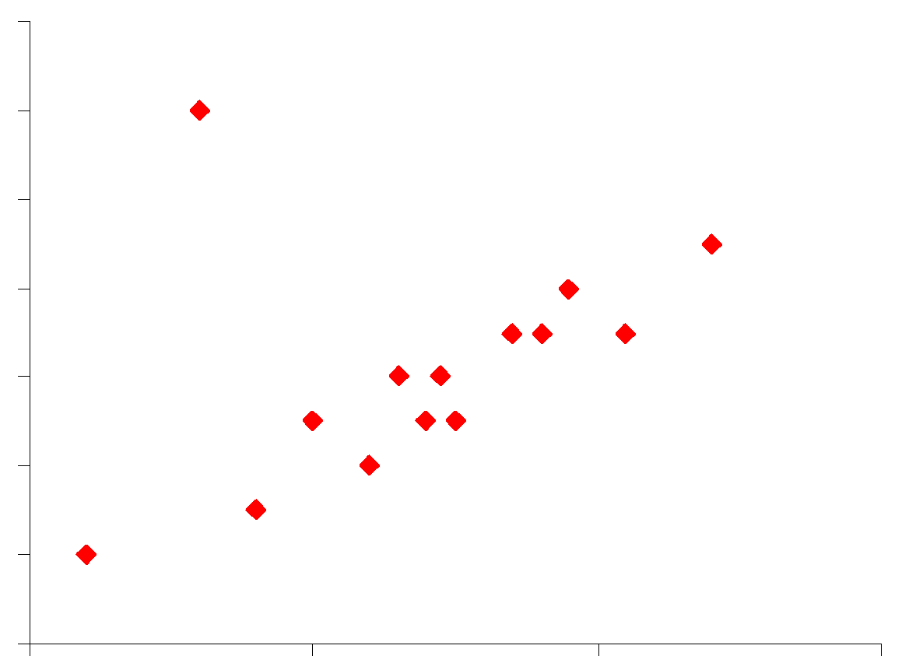
Outliers Can Have a Large Influence
Outlier
With the outlier, r ≅ 0
Without the outlier, r ≅ .8
*
Chapter 4
‹#›
Notes:
HS 67
*
Chapter 4 (Correlation)
‹#›
From Seeing Through Statistics, 2nd Edition by Jessica M. Utts.

Slide 24
Association does not imply causation
See text pp. 144 - 146

Slide 25
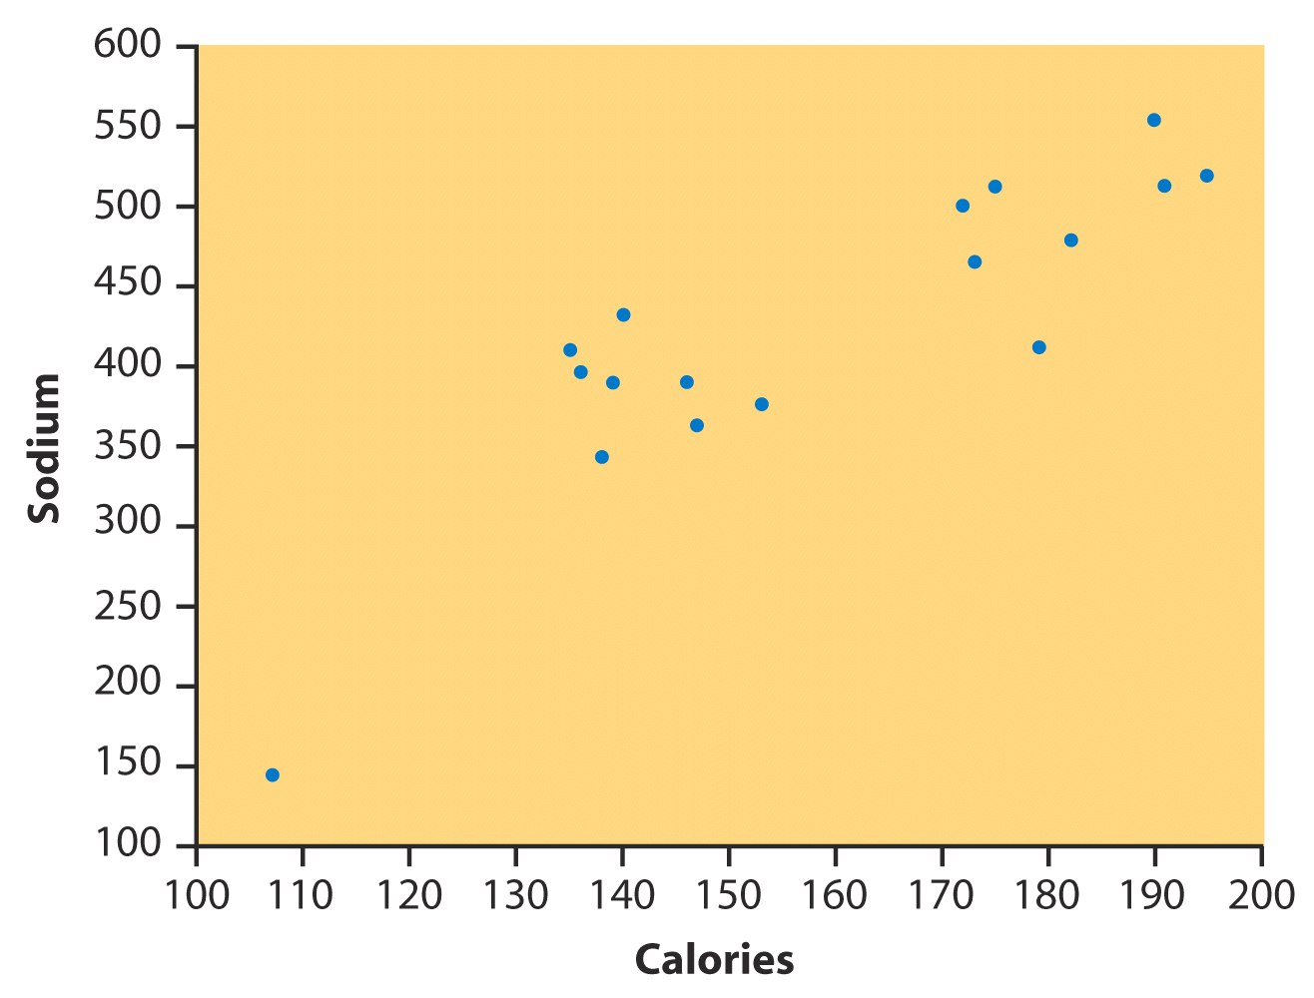
Additional Practice: Calories and sodium content of hot dogs
What are the lowest and highest calorie counts? …lowest and highest sodium levels?
Positive or negative association?
Any outliers? If we ignore outlier, is relation still linear? Does the correlation become stronger?
*
Chapter 4
‹#›

Slide 26
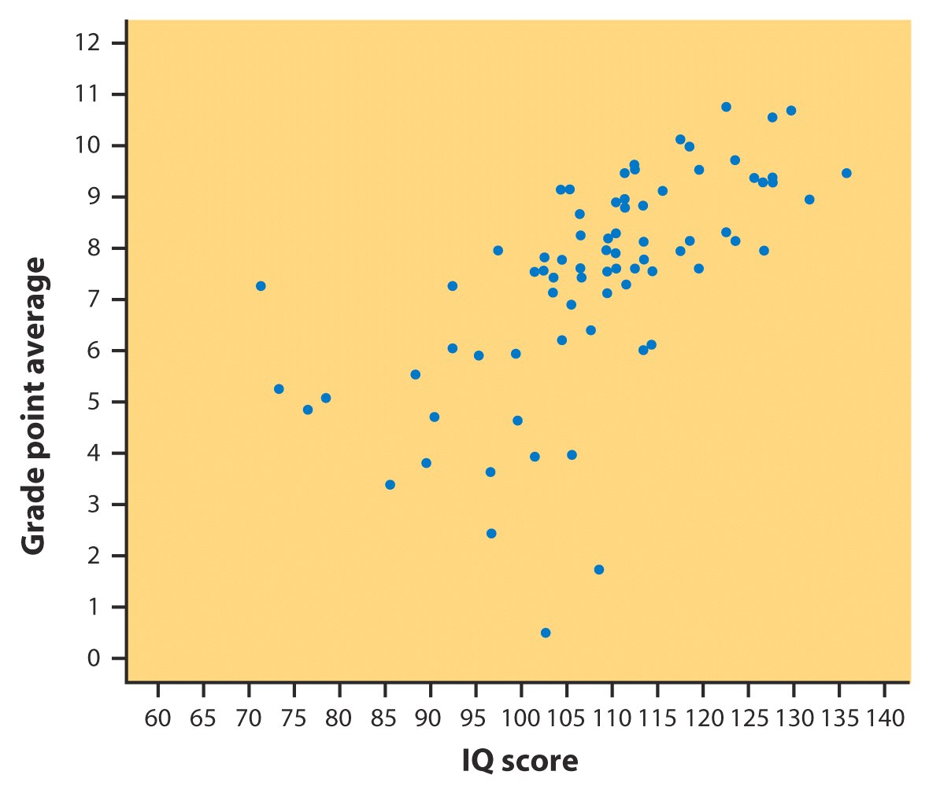
Additional Practice : IQ and grades
Positive or negative association?
Is form linear?
Does correlation strong?
What is the IQ and GPA for the outlier on the bottom there?
*
Chapter 4
‹#›

